Slide 1
Knowledge Representation
Chapter 4

Slide 2
Definition
To make machine intelligent we need to provide machine knowledge.
Knowledge is a facts, skills which is called from our experience and intelligent is ability to use that knowledge.
Reasoning is processing of knowledge.
Eg: “when we jump from 5 storey building, we will break our legs” which is called knowledge.
Now if we jump from 5 storey then we are not intelligent, and if we donot then we are intelligent.
Our target is to put knowledge inside machine so that at right time machine can take decision by taking that knowledge.

Slide 3
If we put incorrect knowledge inside machine then, our machine will perform wrong, similarly if we put right knowledge then our machine will perform right.
If we cannot represent knowledge properly, then there can be error like
Syntax error: grammatical errror eg: I is taking food
Symantic error: meaning errorr: eg: I eat bus inside noodles.
So if we do this syntax and semantic errror less then machine can understand knowledge properly.
To store knowledge inside machine memory is called knowledge representation.

Slide 4
So to do knowlege representaion in machine there are following ways:
Logic: logic can be two types: Propositional logic and predicate logic.
Propositional logic: True or False types
Predicate logic: For all, there exists. To do this quantifiers are used.
Rules: if then
Semantic Net: semantic means meaning and net means graph so semantic net means meaniningful graph eg: google graphs.
Frames: here objects are stored in slots and attributes are stored in filllers.
Scripts: this is a scripts wrriten to perform certain job.

Slide 5
Issues in knowledge representation
Main objectives of knowledge representation is to draw conclusion from knowledge and to make machine take right decision based on its knowledge.
But there are some issues in knowledge representation which are:
Important Attributes
Relationship among attributes
Choosing Granularity: how much detail should i use while while I include in model.
Set of objects
Finding right structure

Slide 6
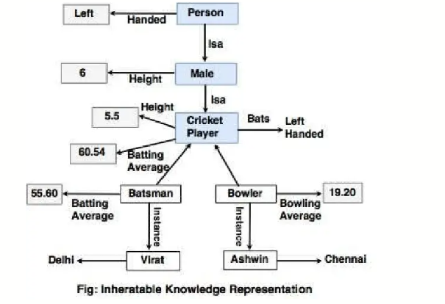

Slide 7
Important Attributes:
Any attributes that may occur in every problem domain.
Eg instance and isa supports property of inheritance so they are important attributes.
Person is a male.
Virat instance batsman.

Slide 8
Relationship among attributes:
There are four properties:
Inverse: it is used to check consistency when a value is added to an attribute.eg:Example:
Ram is the father of Shyam.
Then Shyam is the son of Ram.
Here:
father_of is the inverse of son_of.
When a value is added to one attribute, the inverse attribute can be checked or updated automatically, helping maintain consistency in the knowledge base

Slide 9
Existence: it is used for ‘is-a” hierarchy used for generalization and specialization
Reasoning for a value: eg: a child age must not be greater than parents.
Single value attribute: unique and single valued eg: roll no, citizenship no.

Slide 10
Choosing granularity:
To decide up to what level of knowledge can be represented and what are the primitives.
Eg: car (high detailed)
Engine capacity: 1500cc
Fuel type: petrol
Number of seats: 5
Handbrake: true
Car ( low detailed)
Fuel type: petrol
Category: compact
Here fuel type, category,, engine capacity, handbrake is primitives.

Slide 11
Set of objects:
It can be represented by making set of similar properties of objects.
Now if we have to assert something then we can use it to all the set of objects.
And it is done by universal quantifiers.

Slide 12
Finding right structures:
Selection of appropriate structure is necessary to represent knowledge in machine:
Given a large amount of knowledge stored in a database, how can relevant parts are accessed when they are needed?
This is about access to right structure for describing a particular situation.
This requires, selecting an initial structure and then revising the choice.
While doing so, it is necessary to solve following problems:
How to perform an initial selection of the most appropriate structure.
How to fill in appropriate details from the current situations.
How to find a better structure if the one chosen initially turns out not to be appropriate.
What to do if none of the available structures is appropriate.

Slide 13
Knowledge base representation system and its properties
Knowledge representation system is a formalized structure and sets of operations that contains the descriptions, relationships and procedures provided in an AI system.
The process considers how to represent the knowledge in the system such that it can be used to solve problems.
It basically consists of two components:
Knowledge base
Inference methods

Slide 14
Knowledge base: A knowledge base (KB) is a centralized repository which is a collection of structured an unstuructred information to solve problems or answer querries that an AI system uses to simulate human decision-making.
It can include
Facts ( eg: water boils at 100 degree)
Rules ( eg if temp is greater than 100 degree then its starts boiling)
Heuristics ( experience based system)
Ontologies ( structured concepts and relationships)

Slide 15
Inference methods: it is a technique to derive a new knowledge or conclusions from existing knowledge in a knowledge base system.
It can be :
Inductive inference: eg sun get rised today, yesterday and the day before in morining.
Inferred rule: sun always rises in morning. (specific to general)
Deductive inference: eg all humans are mortal and ram is human. So deductive inference rule can be ram is mortal ( general to specific)

Slide 16
Facts
heuristics
Explanations
querries
End-user
interface
Inference
Engine
Knowledge
Base
Conclusions expertise recommendations for actions
Fig: knowledge representaion schemans
Knowledge representation schemans

Slide 17
Properties
Representation Adequacy: Knowledge system has the ability to represent all kinds of required knowledge in model, theory or data structure.
Inferential adequacy: it is the ability to manipulate knowledge represented to produce new knowledge corresponding from original knowledge.
Inferential efficiency: It is how effectively a system finds the right answer using minimal and relevant reasoning steps.Eg: When a system has many facts stored, it can draw conclusions in many ways. Inferential efficiency means:
It chooses the most relevant facts
It avoids unnecessary reasoning
It finds answers faster
Acquisitional efficiency: it is the ability to take input new knowledge, skills or representation using automatic methods possible rather then reliance on human intervention.

Slide 18
Suppose we have knowledge:
A Dog is a type of Animal
A Dog has a Tail
A Dog can Bark
then this knowledge can be represented in Semantic nets as
Tail
Animal
Is a
has
DOG
can
Bark

Slide 19
Semantic Nets
A Semantic Net is a graph-based structure:
Nodes represent concepts or entities (e.g., "Dog", "Animal", "Barks").
Edges represent relationships between these concepts (e.g., "is a", "has", "can").
Semantic networks often include:
Inheritance: "A cat is a mammal" → inherits properties of mammals.
Part-whole: “dog has tail"
Action-capability: “Dog can Bark“
Cause-effect: "Fire causes smoke“

Slide 20
Semantic Nets
Semantic Nets in AI (also called Semantic Networks) are a way of representing knowledge using a graph of interconnected concepts.
They're one of the earliest and most intuitive methods for representing meaning in artificial intelligence, particularly useful in natural language processing, expert systems, and knowledge representation.

Slide 21
Components of a semantic network
Nodes (Concepts or Entities):
Represent objects, concepts, or ideas
Eg dog, animal, tail,bark
Edges (Links or Arcs)
Represent relationships between concepts.
Eg: is a , has, can
Labels:
Descriptive names given to edges to define the type of relation.
Examples: "is a", "part of", "has property“
Inheritance
A mechanism by which nodes inherit properties from parent nodes via "is-a" links.
Types of relationship
Inheritance: "A cat is a mammal" → inherits properties of mammals.
Part-whole: “dog has tail"
Action-capability: “Dog can Bark“
Cause-effect: "Fire causes smoke“

Slide 22
General Components
Lexical components: Nodes, links and labels.
Structural components: directed links or nodes.
Semantic : related to links or nodes for eg facts.
Procedural:
Constructor: creation of new links.
Destructor: removal of new links.

Slide 23
Frames
Frames are data structures used in AI to represent stereotypical situations or scenarios.
They encapsulate information about objects, events, and their interrelationships within a particular context.
Each frame consists of a set of attributes and values, forming a template for understanding specific situations.
Frames are designed to provide a structured way to capture the essential aspects of a situation, facilitating easier retrieval and manipulation of information.
They are similar to schemas or blueprints that organize knowledge into manageable chunks.

Slide 24
Components
Slots:
Slots are attributes or properties of a frame. They represent the different aspects or characteristics of the frame's concept.
Example: For a "Person" frame, slots might include:
Name: The individual's name
Age: The individual's age
Occupation: The individual's profession
Address: The individual's home address

Slide 25
2. Facets
Facets provide additional details or constraints for slots, defining acceptable values or specifying how slots should be used.
Example: For the "Age" slot in the "Person" frame:
Type: Integer
Range: 0 to 90
Default Value: 20

Slide 26
Default Values
Default values are predefined values assigned to slots if no specific value is provided. They offer a baseline that can be overridden with more specific information.
Example: In a "Car" frame:
Make: Default value could be "Unknown"
Model: Default value could be "Unknown"
Year: Default value could be the current year

Slide 27
Procedures
Procedures are methods or functions associated with frames that define how the information within the frame should be processed or utilized.
Example: In an "Account" frame:
Procedure: CalculateInterest - A method to compute interest based on the account balance.

Slide 28
Example of Frame Inheritance
Parent Frame: "LibraryItem“
Attributes:
Title
Author
Publication Year
Child Frame 1: "Book" (inherits from "LibraryItem")
Inherited Attributes: Title, Author, Publication Year
Extended Attributes:
ISBN
Genre

Slide 29
Child Frame 2: "Magazine" (inherits from "LibraryItem")
Inherited Attributes: Title, Author, Publication Year
Extended Attributes:
Issue Number
Publisher

Slide 30
Conceptual Dependencies
Conceptual Dependency originally developed to represent knowledge acquired from natural language input.
Helps computers understand the meaning of language rather than just the words.
The goals of this theory are:
To help in the drawing of conclusion from sentences.
Eg: The system should be able to infer information that is not explicitly stated.
Example: Sentence: "Ram gave Sita a book."
The system can conclude:
Ram had the book before giving it.
Sita has the book after receiving it.

Slide 31
To be independent of the words used in the original input.
Different sentences with the same meaning should have the same internal representation. Example: "John gave Mary a pen."
"Mary received a pen from John."
Although the wording is different, both sentences represent the same action of transferring possession.

Slide 32
Examples of Primitive Acts
ATRANS -- Transfer of an abstract relationship. e.g. give.
PTRANS -- Transfer of the physical location of an object. e.g. go.
PROPEL -- Application of a physical force to an object. e.g. push.
MTRANS -- Transfer of mental information. e.g. tell.
MBUILD -- Construct new information from old. e.g. decide.
SPEAK -- Utter a sound. e.g. say.

Slide 33
ATTEND -- Focus a sense on a stimulus. e.g. listen, watch.
MOVE -- Movement of a body part by owner. e.g. punch, kick.
GRASP -- Actor grasping an object. e.g. clutch.
INGEST -- Actor ingesting an object. e.g. eat.
EXPEL -- Actor getting rid of an object from body.

Slide 34
Conceptual categories
ACT (Actions) :
Represents an action or event (one of the CD primitives).
Examples: eat, give, move, speak.
PP (Picture Producer/Picture Procedure) :
Objects Represents objects, people, or things involved in the action.
Examples: Ram, book, ball, car.
AA (Action Aider)
Modifiers of actions Describes how an action is performed.
Similar to adverbs.
Examples: quickly, slowly, carefully.

Slide 35
PA (Picture Aider) :
Modifiers of PP's Describes the properties or attributes of objects.
Similar to adjectives.
Examples: red ball, tall boy, heavy box.
Sentence: "The tall boy quickly kicked the red ball."
ACT: kicked
PP: boy, ball
AA: quickly
PA: tall (modifies boy), red (modifies ball)

Slide 36
Conceptual categories
Four conceptual categories:
ACT: Actions ( one of the CD primitives)
PP : Objects ( picture procedure)
AA : modifier of actions ( action aiders)
PA : Modifiers of PP’s ( picture aiders)
Example1: I gave a book to the man.
CD representation as follows:
I ATRANS BOOK
MAN
I

Slide 37
Where, indicates direction of dependency.
indicates direction of dependency.

Slide 38
Rule 1: PP ACT : it describes the relationship between an actor and the event he or she causes.
Eg: John went.
John PTRANS
Rule 2: ACT PP: it describes relationship between ACT and a PP (object) of ACT.
Eg: John pushed the bike.
CD representation is : john PROFEL bike.
Rule 3: PP PP : It describes relationship between two PP one of which belongs to set defined by the other.
Eg: John is a doctor.
CD representation is : John doctor

Slide 39
Rule 4: PP PP
It describes the relationship between two PP’s one of which provides a ownership kind of information about the other.
Eg5: John’s dog.
CD representation is : dog john
Rule 5: PP PA : it describes the relationship between a PP and PA that is asserted to describe it.
Eg: John is fat.
CD is represented as : John weight ( >80).
Poss-by

Slide 40
Scripts
Used for knowledge representation.
Scripts is a structure that prescribes a set of circumstances which could be expected to follow on from one another.
Considered to consist of a no. of slots or frames but with more specialized roles.

Slide 41
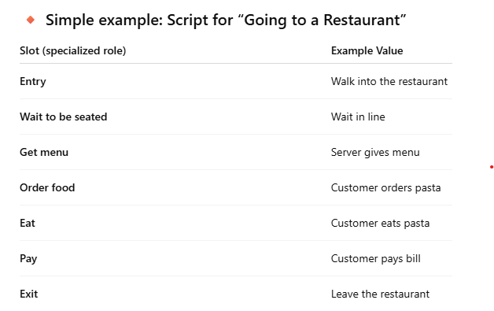

Slide 42
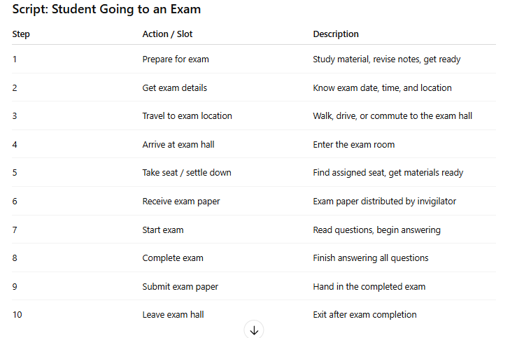

Slide 43
Components of scripts
Roles: person involved in events. Eg: student appears exam. Here student is roles.
Props: objects involved in event. Eg: for student to appear in exam pen, pencil are pros.
Entry conditions: condition that need to be satisfied before event occur in scripts. For eg: entry condition can be student must clear tution fee or exam must be conducted.
Results: results that will be true when event occurs mentioned in scripts.eg: students starts writing on answer sheet when he gets question paper so students writing is result.
Track: variations on the script. For eg if we have script student going on exam then same slots may be shared on loksewa exam script and also on college board exam scripts.
Scenes: sequence of events occur.

Slide 44
Rule based systems ( Production System)
A rule based system ( or production system) is a knowledge Based System ( KBS) in which the language is stored as rules, where the rules come from human experts in a particular domain.
It represent knowledge in the form of condition-action pairs called production rules.
If condition C is satisfied then the action A is appropriate.
Example:
If it is raining then open the umbrella.
If Ram is a man then Ram is a person.

Slide 45
In RBS the knowledge is separated from AI reasoning processes, which means that new RBS are easy to create.
The syntax is :
IF < premise> THEN < action>
Components:
Working memory: small memory into which only appropriate rules are copied.
Rule Based: to facilitate efficient access to the antecedent.
Eg: IF (temperature > 100°F) THEN (status = "overheated"), here temperature > 100°F is antecedent.
Interpreter: processing engine.

Slide 46

Tautology
Tautology is a statement that is always true, no matter what the truth values of its components are.
It’s a formula or proposition that cannot be false under any interpretation.
Examples of tautologies:
“It will either rain tomorrow or it will not rain tomorrow.” (This is always true because it covers all possibilities.)
In logic notation:

Slide 47
Validity in propositional logic
A sentence is said to be valid if it is true in all models.
Valid sentences are also knows as tautologies.
Every valid sentence is logically equivalent to TRUE.
Eg: A∨¬A
Prove how : A∨¬A is valid? Use truth table.
A | ¬A | A∨¬A
T | F | T
F | T | T

Slide 48
Satisfiability in propositional logic
A sentence is satisfiable if it is true in some model.
Eg: : A∨A
A sentence is unsatisfiable if it is true in no model.
Eg: A∧¬A

Slide 49
Forward chaining
Forward chaining is the logical process of inferring unknown truth from know data in knowledge base and moving forward using determined conditions and rules to find a solution.
It is also known as data driven reasoning.
It is a process of making conclusion based on known facts of data by starting from the initial state and reach the goal state.
Forward chaining is commonly used in expert system.

Slide 50
Background Chaining
A background chaining algorithm is a form of reasoning, which starts with the goal and works background, chaining through rules to find known facts support the goal.
It is based on modus ponens inference rules.
A background chaining, the goal is broken into sub-goal or sub-goals to prove the facts true.
It is called a goal-driven approach as a list of goal decides which rules are selected and used.
Backward-chaining algorithm is used in game theory, automated theorem proving tools, inference engines, and various AI applications.
The backward-chaining method mostly used a depth-first search strategy for proof.

Slide 51
Lifting
In Artificial Intelligence (AI), lifting refers to reasoning or representing problems at an abstract, symbolic level using variables and general rules, rather than at the concrete or specific (ground) level.
Lifting in Logical Inference
∀x (Human(x) → Mortal(x)) → All humans are mortal
Human(Socrates) → Socrates is a human
Lifting: Instead of applying this rule separately for each human, the rule is lifted: it applies generically to any x
Lifting in Machine Learning (Inductive Logic Programming)
You have training data
Cat(Whiskers)
HasTail(Whiskers)
Cat(Felix)
HasTail(Felix)
Learn a general rule: ∀x. Cat(x) → HasTail(x)

Slide 52
FOPL (First-Order Predicate Logic)
First-Order Predicate Logic is a system of logic that represents objects, their properties, and the relationships between objects using predicates, variables, constants, functions, logical connectives, and quantifiers.
For example, suppose the universe of discourse is student in BSCSIT 4th sem then,
Objects: ( Shyam, Sahan, Sohil, Anushka)
Student (x)
x holds any value of objects.
In FOPL objects are represented by “CONSTANT”.
‘Student’ is predicate.

Slide 53
Components of FOPL
Constants
Represent specific objects.
Examples: Ram ,Kathmandu .5
Variables
Represent any object in the universe of discourse.
Examples: x ,y ,z
Predicates
Represent properties of objects or relationships between objects.
Examples:
Student(x) → x is a student.
Likes(Ram, Apple) → Ram likes apples.
Greater(5, 3) → 5 is greater than 3.

Slide 54
Functions
Return an object.
Examples: Ram's father is Shyam.
It can be written as FatherOf(Ram) = Shyam
Here:
Input: Ram (an object)
Function: FatherOf
Output: Shyam (another object)

Slide 55
Logical Connectives
∧ (AND)
∨ (OR)
¬ (NOT)
→ (IMPLIES)
↔ (IF AND ONLY IF)
Quantifiers
Universal Quantifier (∀): "For all"
Example:
∀xStudent(x)→Human(x)
Meaning: Every student is a human.
Existential Quantifier (∃): "There exists"
Example:
Student(x)∃xStudent(x)
Meaning: There exists at least one student.

Slide 56
Properties of Quantifier
∀x∀y≡∀y∀x
∃x∃y≡∃y∃x
∀x∃y not equals to∃y∀x

Slide 57
Handling uncertain knowledge
Agents need to handle uncertainity whether due to partial observability, no-determinism or combination of both.
An agent may never know for certain what state it in or where it will end up after sequence of actions.
Although agent already have the knowledge about environment but due to some external natural factor agent will not be able to achieve actual mathematical interpretation goal, so it must take decision by analyzing external factors and that decision is called rational decision.
Eg automated decision.

Slide 58
Lets take another example of uncertain knowledge in simple rule.
Toothache cravity
The rule itself is wrong in real scenario, not all patients with toothache have cavities, some of them have gum disease or any other problems.
Now the rule becomes:
Toothache cavity ∨gum disjunction ∨ disease etc.
Unfortunately in order to make rule true we have to add almost unlimited list of possible problems.
So to move from one state to another state any fixed rule is applied, this case is considered as condition of uncertainty.
The only decision of uncertainty will be generated from probability theory.

Slide 59
Random variables
The variables whose possible values are numerical outcomes of a random phenomena is known as random variable.
There are two types:
Discrete
Continuous

Slide 60
Probability and its types
Simply probability is a number that reflects the chance or likelihood of that particular even occurrence.
The degree of belief in proposition in the absence of any other information is called unconditional or prior probability.
Eg:
P(A) = total number of ways that event A occurred/total number of possible outcomes
The probability of the event occurring with some relationship to one or more events is called conditional or posterior probability.
Eg: P(A/B) = P(A^B)/P(B)
Decision theory=Probability theory + utility theory.

Slide 61
Inference using Full Joint Distribution
The process of generating knowledge by using joint probabilty is called an inference using full joint probability distribution.
It is the statistical measure that calculate the likelihood of two events occurring together at same point of time.

Slide 62
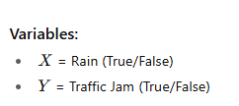
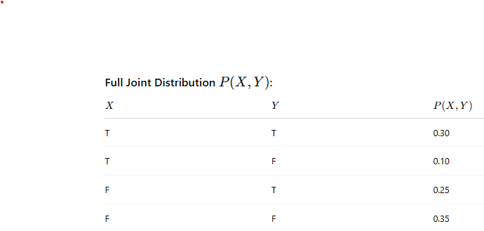

Slide 63
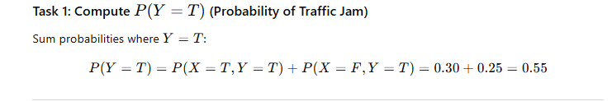
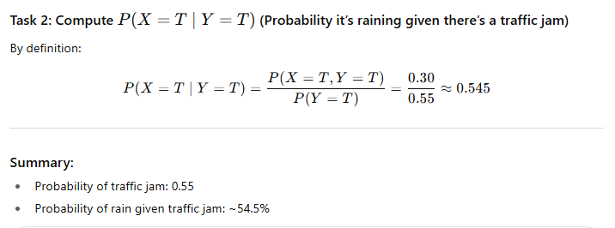

Slide 64

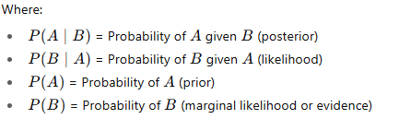
Bayes rules and its uses
Bayes’ Theorem is a rule in probability theory that describes how to update the probability of a hypothesis A based on new evidence B.
It relates the conditional and marginal probabilities of random events.

Slide 65
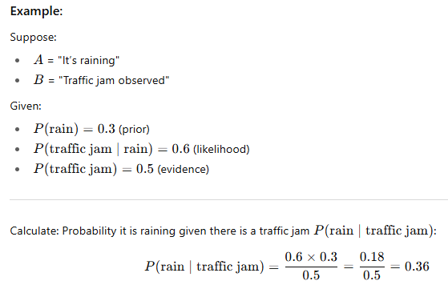
Example

Slide 66
Uses
It is widely used to provide probabilistic prediction in AI.
In finance, Baye’s theorem can be used to rate the risk of lending money to potential borrowers.
It allows to update predicted probabilities of an event by incorporating new information.

Slide 67
Bayesian Network
It is probabilistic graphical model that represents a set of variables and their conditional dependencies through a Directed Acyclic Graph (DAG).
A
C
B

Slide 68
Example
Sprinkler
Rain
RAIN
R | NOT RAIN
0.2 | 0.8
Grass Wet
Sprinkler
Grass Wet
Sprinkler | Rain | Wet | NOT Wet
F | F | 0.0 | 1
F | T | 0.8 | 0.2
T | F | 0.9 | 0.1
T | T | 0.99 | 0.01
Rain | Sprinkler
F | 0.4
T | 0.01
NOT Sprinkler
0.6
0.99

Slide 69
P ( W^S^R)=P (W|S,R) * P(S|R) * P(R)
=0.99*0.01*0.2
=0.00198
Find P(W|notS,notR)

Slide 70
Inference in Belief network
Inference in belief networks means computing probabilities of some variables given known values (evidence) for others.
This is a core function in probabilistic reasoning and AI.

Slide 71
Fuzzy Logic
The word fuzzy refers to things which are not clear means uncertainty.
Eg: I have eaten many fruits or I have slept a lot. This type of statement is represented by fuzzy logic because a lot and many means how much.
For someone 10 hours sleep can be much or 1 kg fruits can be many or for someone that 1kg can be less.
So degree is represented in fuzzy logic.
Any event, process or function that is changing continuously cannot always be defined as either true or false, which means that we need to define such activities in a fuzzy manner.
In fuzzy systems, the values are indicated by a number in the range from 0 to 1.
Here 1.0 represents absolute truth and 0.0 represents absolute false.
The number which indicates the value in fuzzy system is called truth table.

Slide 72
yes
Clear
Bivalued/Boolean logic
no
May be
Clear
slightly
Multivalued logic or Fuzzy logic
Might be

